Slide 1
MVP Presentation : Skynet Nexus
Idea Title
FactoryMind Unified Agentic AI Platform for Predictive Maintenance & Smart Manufacturing
College
Panimalar Engineering College
Team Lead
Team Members
Vishal I. M
Deekshitha G • Nithya Sri A • Muralidharan J

Slide 2








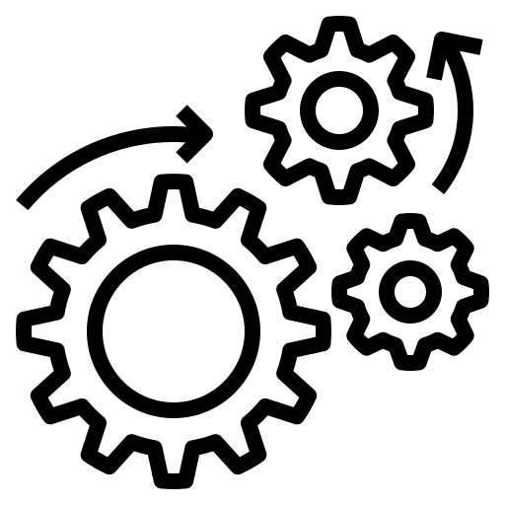



FactoryMind : Unified Agentic AI Platform
THE PROBLEM
OUR SOLUTION
A critical challenge that needs urgent attention
An intelligent , automated and future-ready approach
Financial Drain
Our AI Platform monitors, predict and fix problems before they cost.
Blind
Operations
Reactive
Maintenance
Digital Twin
Vision AI
Predictive Maintence
Sustain+GenAI
Mirror. Sync. Simulate
See. Detect.
Flag
Track. Advise. Sustain
Predict. Alert.
Fix
Sustainability Blindspot
Manual Quality Inspection
Impact
Outcome
Less downtime Fewer defects. Lower costs. Smarter operations. All in one platform.
Sub 10ms inference . Live factory replica . Defect detection AI . Failure prediction engine . GenAI sustainability advisor

Slide 3









FactoryMind : Unified Agentic AI Platform
Uniqueness / Innovativeness
Business Impact
5-in-1 Manufacturing AI Platform
Cost 50-80L Saved per plant
No competitor unifies edge AI, Vision QC, Digital Twin, Predictive maintenance and GenAI under one roof
Downtime reduction, defect elimination and energy savings combined – every year, per facility
Autonomous Edge-to-Cloud AI
95% detect accuracy
Sub-10ms on device inference meets agentic Bedrock loops – detecting, diagnosing and correcting without human intervention
24x7 rekcognition vision AI outperforms human inspectors at 80-85% with zero fatigue and round-the-clock coverage
GenAI for Every Operator
One Intelligent Platform
30-50% Less Downtime
Ask questions in plain language, get reasoned answers. No data science skills needed. Powered by Claude 3 Sonnet
LSTM predictive models catch failures 24-72 hours early. Each avoided event saves Rs.10-15 Lakhs
Complete Visiblity
42%
96%
18%
65%
Downtime Reduction
Defect Detection Accuracy
Energy savings
Annual Cost Savings

Slide 4


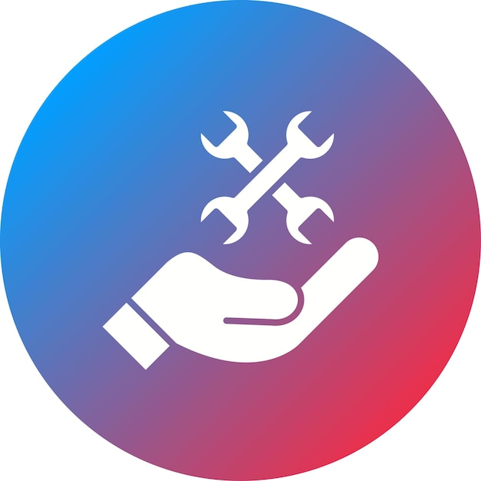









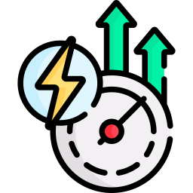
FactoryMind : Unified Agentic AI Platform
Technologies Leveraged
AI / GEN AI Capablities
Data Process
Ingest & Process
Application Layer
AWS IoT Core
PREDICTIVE MAINTENANCE
Secure Device connectivity and ingestion
Secure Device connectivity and ingestion
AWS Kinesis
Machine & Sensors
AWS IOT CORE
Real Time Dashboards
Real Time Data Streaming Provider
ANOMOLY DETECTION
Secure Device connectivity and ingestion
Energy Meters
Alerts & Notifications
AWS S3 Bucket
AWS KENSIS
Maintenance Workflows
GENAI ASSISTANCE
Scalable Storage providing medium
Mainenance Logs
Secure Device connectivity and ingestion
External datas (Weather..., etc..)
DATA ENRICHMENT & FILTERATION
Report Generation
AWS Lambda
INTELLIGENT REPORTING
Event- Driven Serverless computation
Secure Device connectivity and ingestion
ENERGY OPTIMIZATION
AWS Dynamo DB
Secure Device connectivity and ingestion
High performance No-SQL data store

Slide 5




FactoryMind : Unified Agentic AI Platform
Built to Scale.
Designed to Evolve.
Roadmap
Building the future of autonomous manufacturing
Scalable / Reusable
Foundational (MVP)
Expansion
(Beta)
Intelligence
(Scale)
Autonmous
(Vision)
Scalable for Real-World Deployment
0-3 Month
3-6 Month
6-12 Month
12+ Month
High availablity, fault tolerance, and automatic scaling
Support to edge cloud deployments, low latency and real operations
Real Time Monitoring
AI based anomoly detection
Predictive Maintenance System
Advanced AI model & alerts
AI powered quality inspection
Integration with enterprise system
AI Driven Root cause analysis
Autonomous maintenance
Energy optimization & sustainbility
Self Optimizing Operations
Global Scale, Multi tenant platforms
Continuous Learning & Development
Reusable across industries & Use Case
Easy Integration with existing enterprise systems
Modular and configurable for different machinery

Slide 6
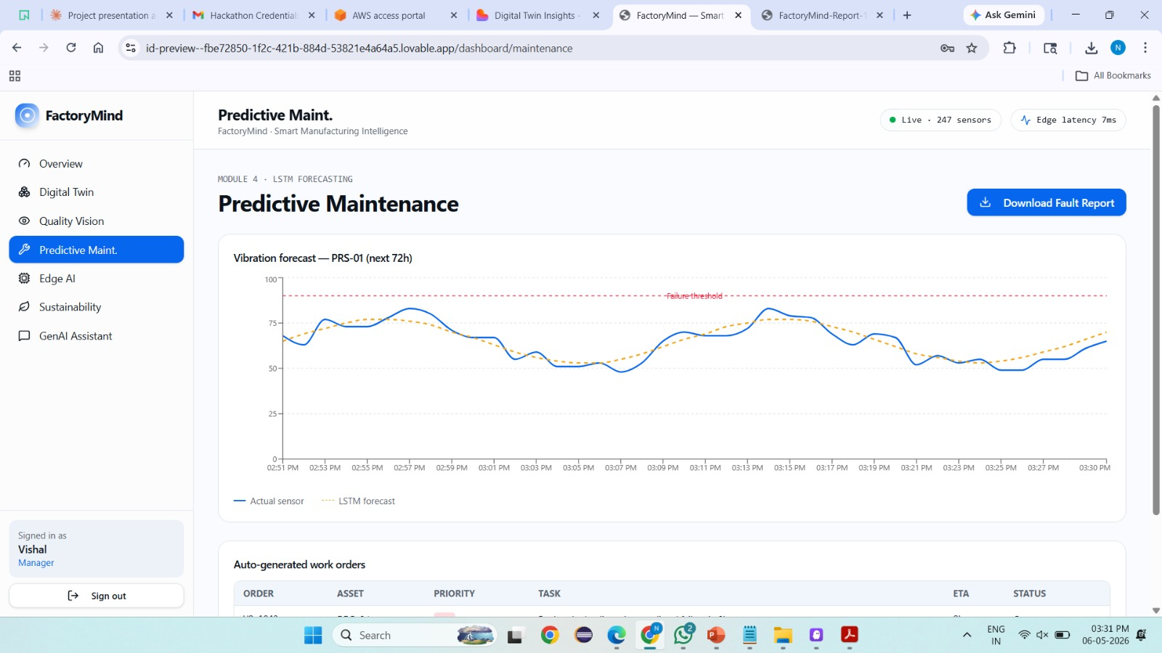
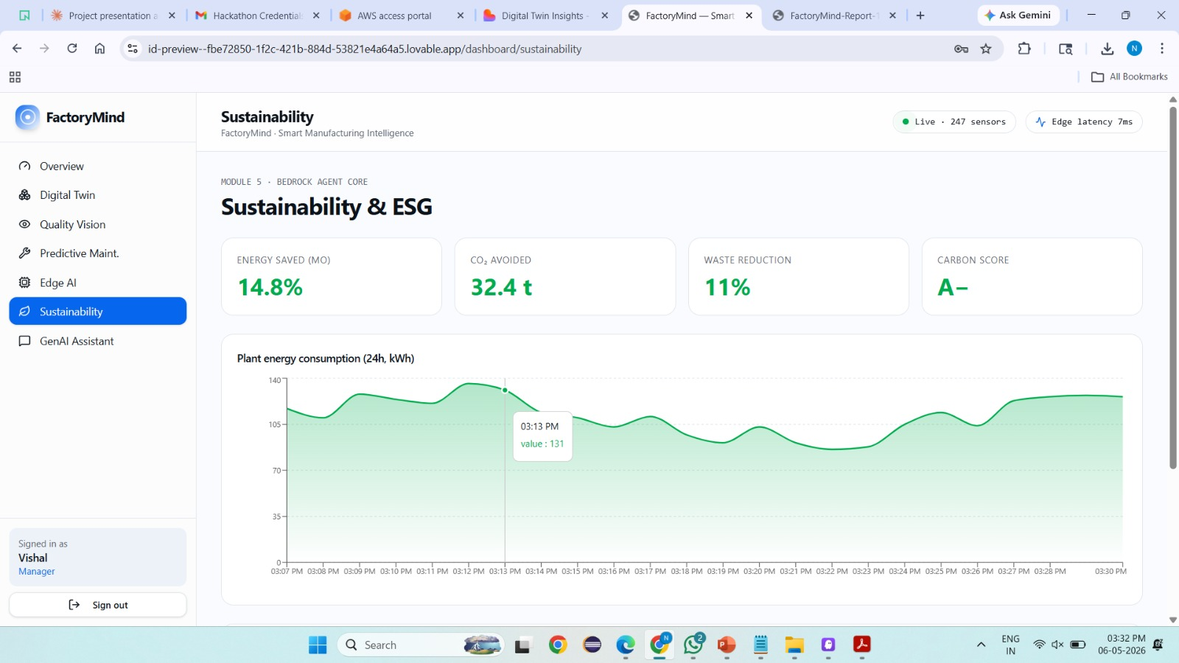
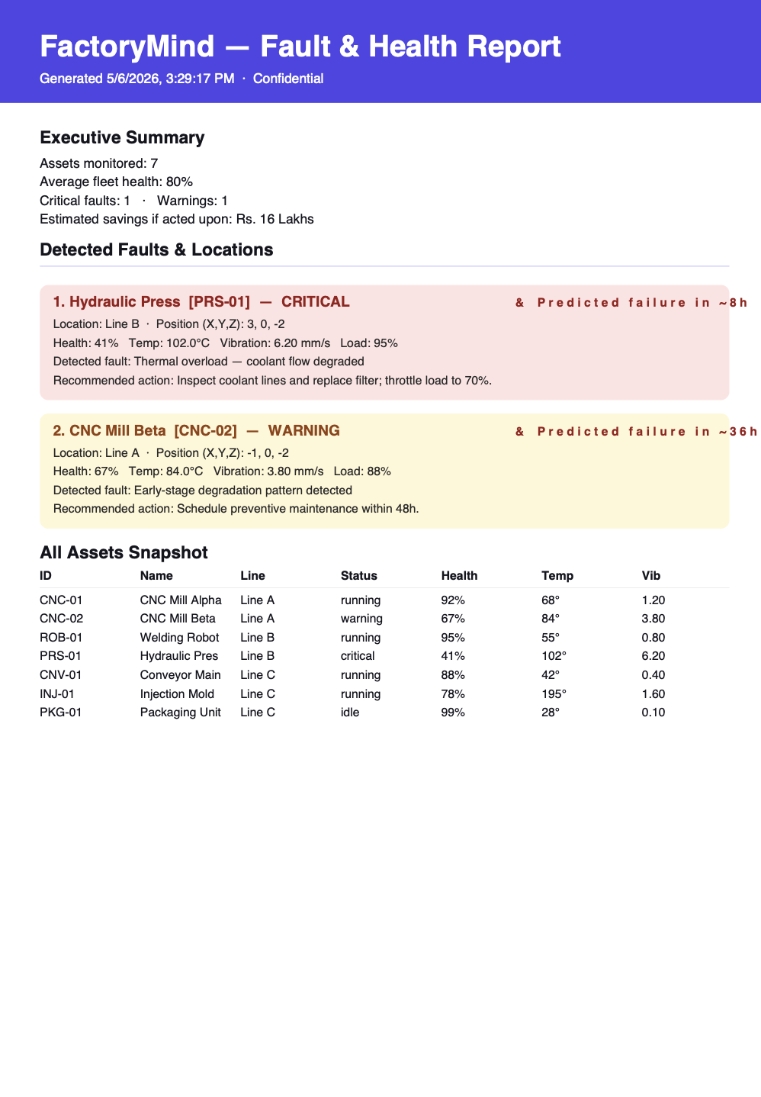
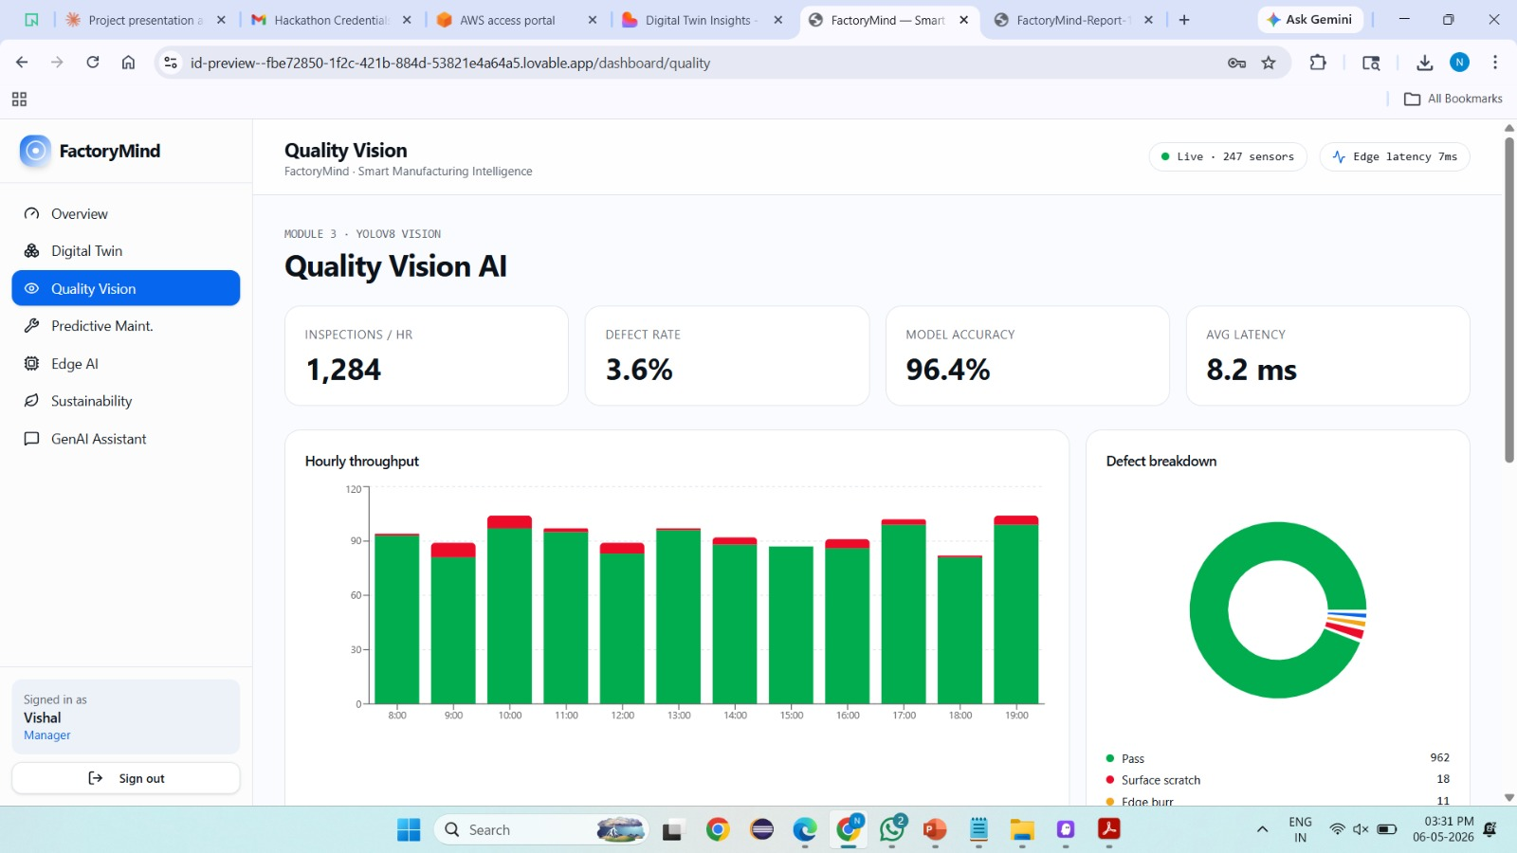
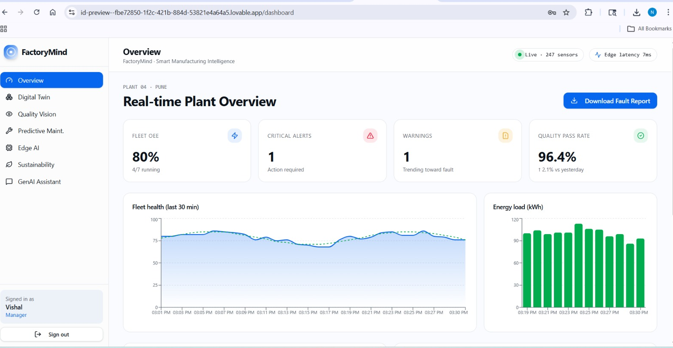
FactoryMind : Unified Agentic AI Platform
Fig 1: Predictive Maintenance Dashboard
Fig 2 : Sustainability Dashboard
Fig 3 : Quality Vision AI Dashboard
Fig 4 : Overview Dashboard
Snapshots of Application - 1/2
Sample Report

Slide 7
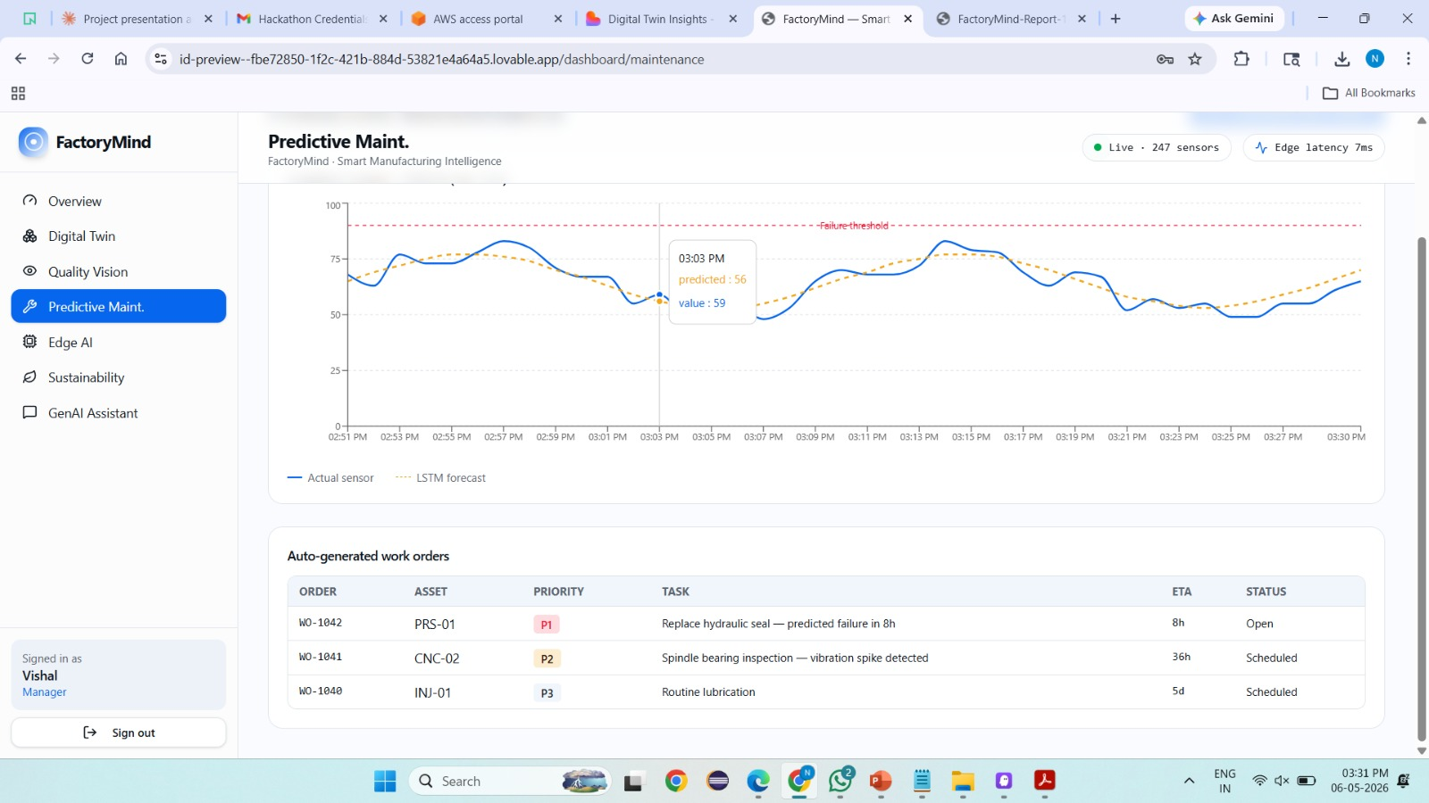
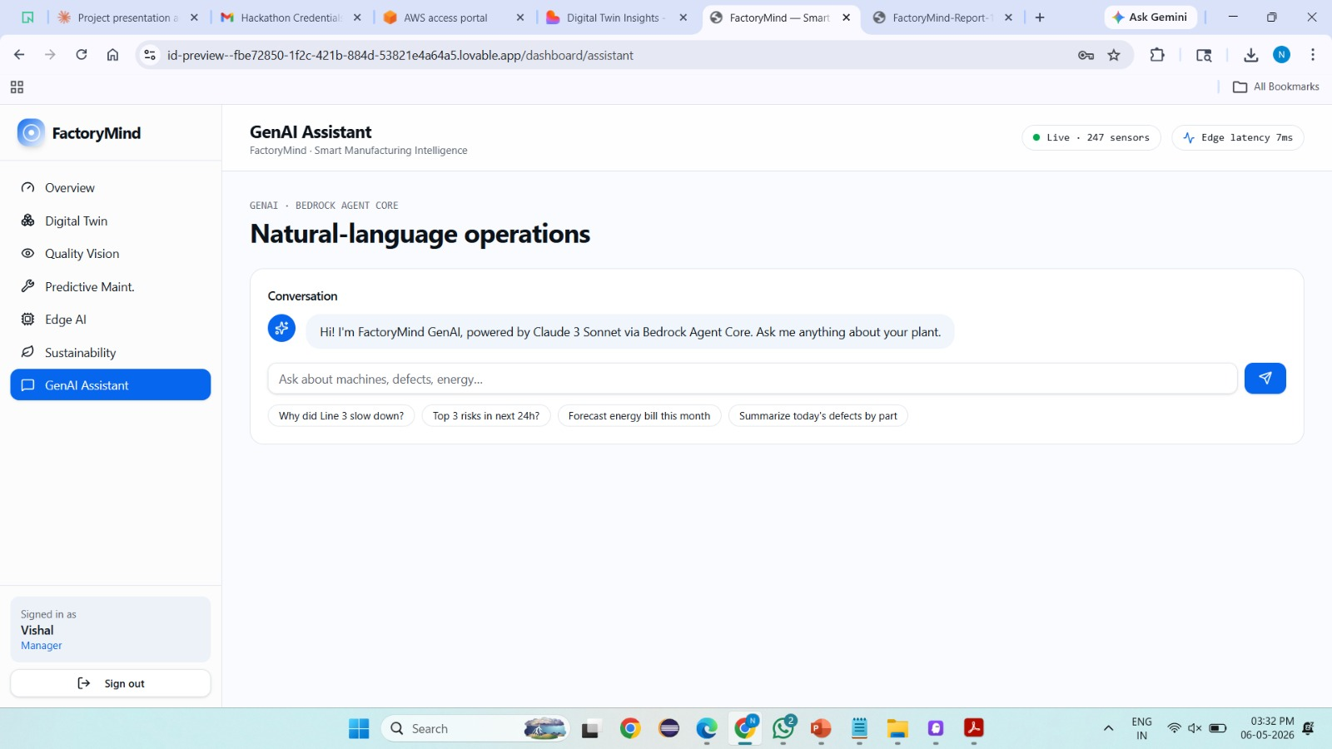
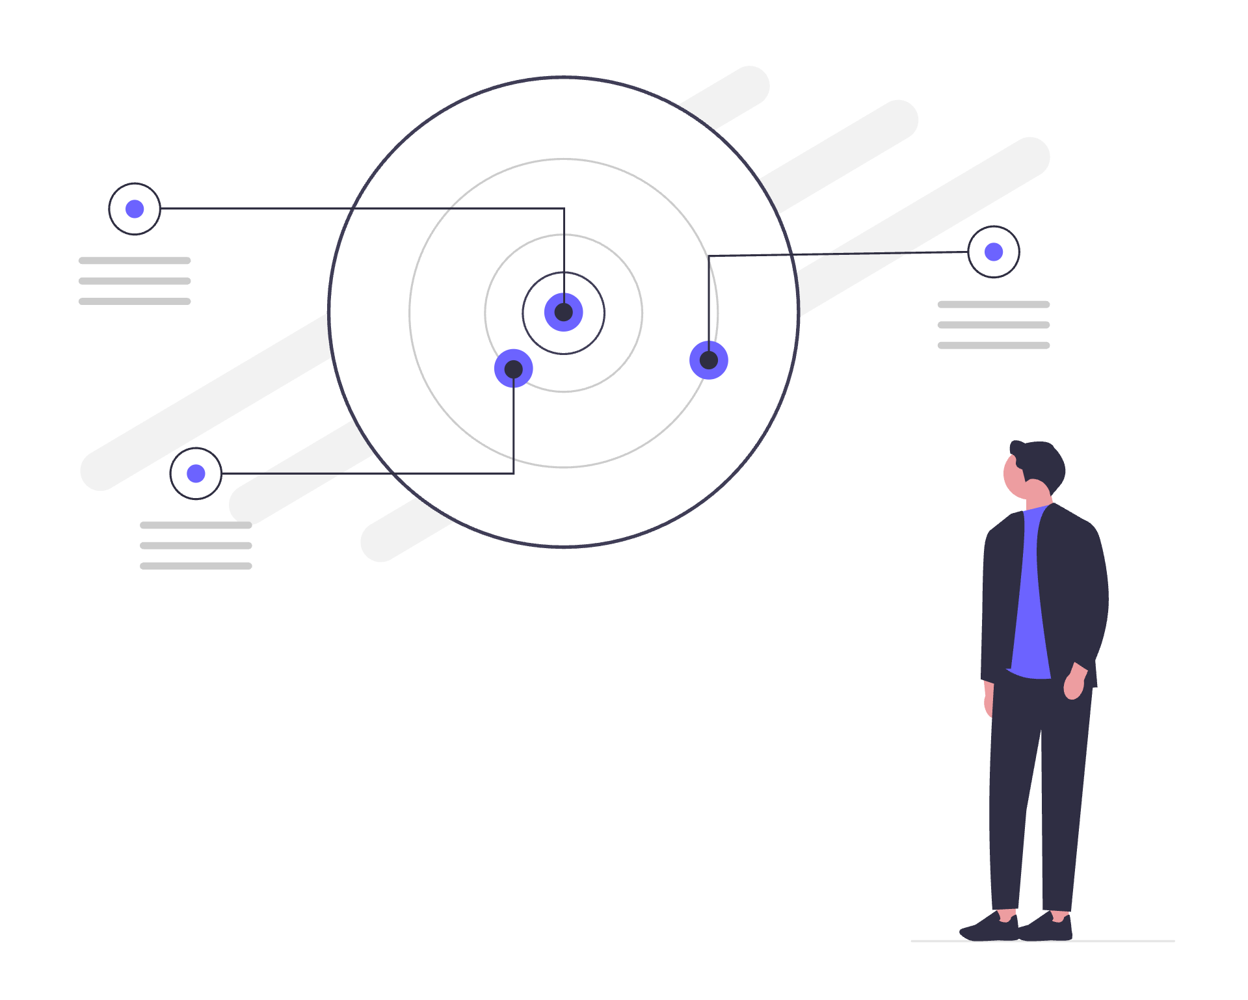
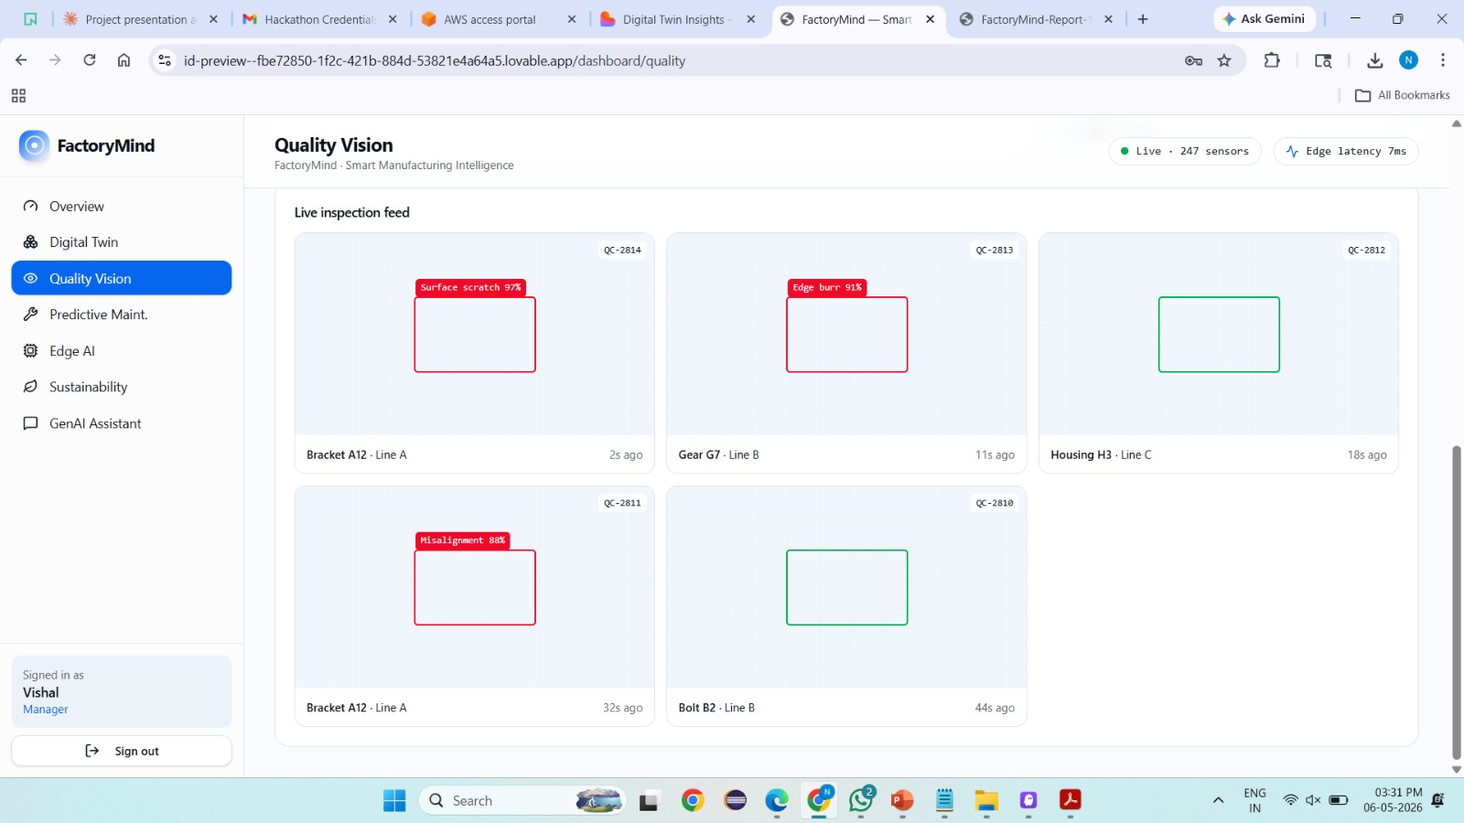
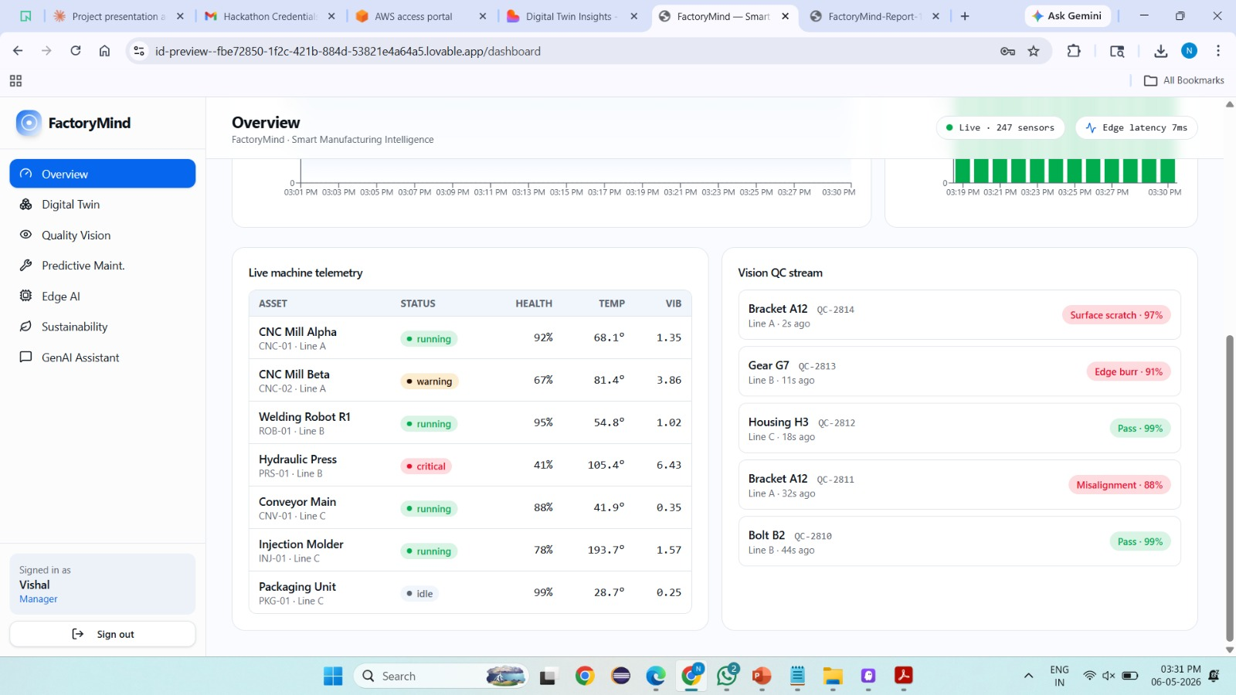
FactoryMind : Unified Agentic AI Platform
Fig 1.1: Predictive Maintenance Dashboard
Fig 2 : Gen AI Assistant Dashboard
Fig 3.1 : Quality Vision AI Dashboard
Fig 4.1 : Overview Dashboard
Snapshots of Application - 2/2

Slide 8

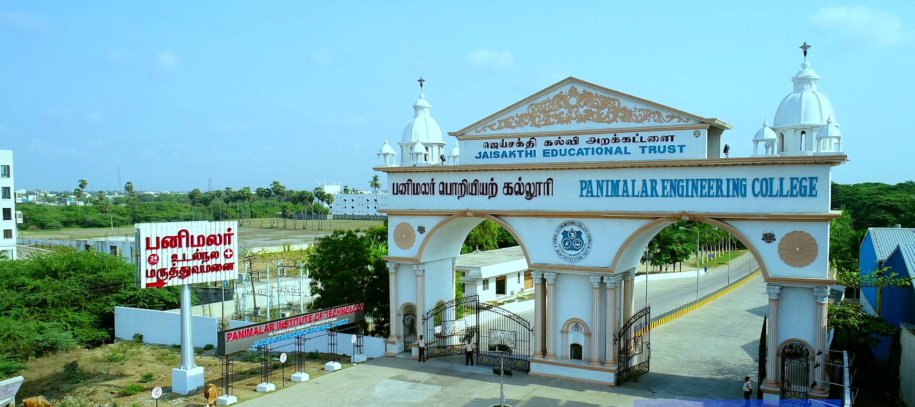
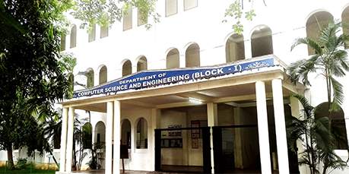
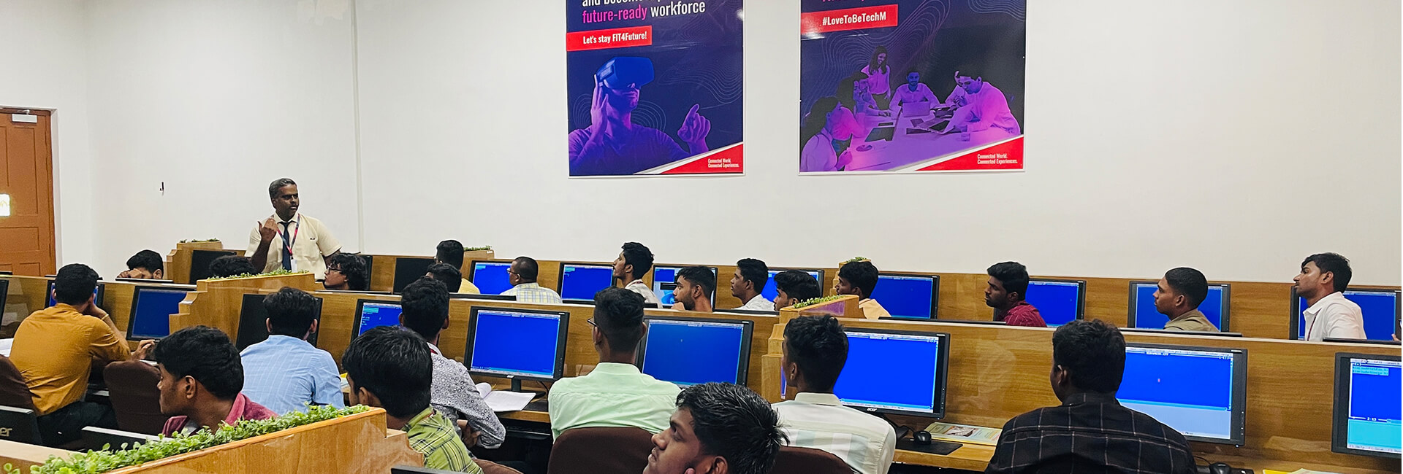
The Journey Behind Nexus.

Slide 9
The Journey Behind Nexus.
How did we came to know about Technoverse
3. Team Formation & Round Clearing Moment
4. Selected For Finale
Recognition of Talent – Being chosen for the finale shows your skills and hard work have been acknowledged.
Competitive Edge – Outperformed many participants to reach the final stage.
Consistency & Dedication – Demonstrated sustained effort and commitment throughout the competition.
High Visibility – Opportunity to showcase abilities in front of judges, peers, and a larger audience.
Learning & Growth – Gained valuable experience and improved through each round.
Motivation for Excellence – Selection boosts confidence and inspires further achievements.
Team/Individual Pride – Represents success not only for yourself but also for your institution or group.
Gateway to Opportunities – Finale participation can open doors to internships, projects, or recognition.
We first heard about Technoverse through College.
The theme of real client challenges with AI caught our attention.
Mentors and peers encouraged us, highlighting it as more than just a coding
We carefully chose teammates with complementary skills – AI, coding, design, and presentation.
Initial brainstorming sessions helped us align on the FactoryMind vision.
Late-night debates shaped our architecture and strengthened our bond.
Each round tested our technical depth and teamwork under pressure.
Clearing the first round gave us confidence that our idea had real potential.
Advancing further proved our solution was not just innovative but practical.
Every round win felt like validation of our hard work and unity.
2. What was the first thought while registering
At first, we honestly felt the competition would be extremely tough.
With multiple teams participating and only a very limited number getting selected, we thought our chances would be quite low.
But we still decided to give our best and take the opportunity seriously.

Slide 10
Thank you
Skynet Nexus​

